Slide 1

Final Project NetW211 March 2022
By: Edward Alvarado

Slide 2
Part 1 Establishing a Virtual Machine
In the first part of our project, we deploy a virtual machine using the Azure platform.
We then connect to our virtual machine.
After finishing we learn the proper way to delete a virtual machine to avoid wasting resources.

Slide 3
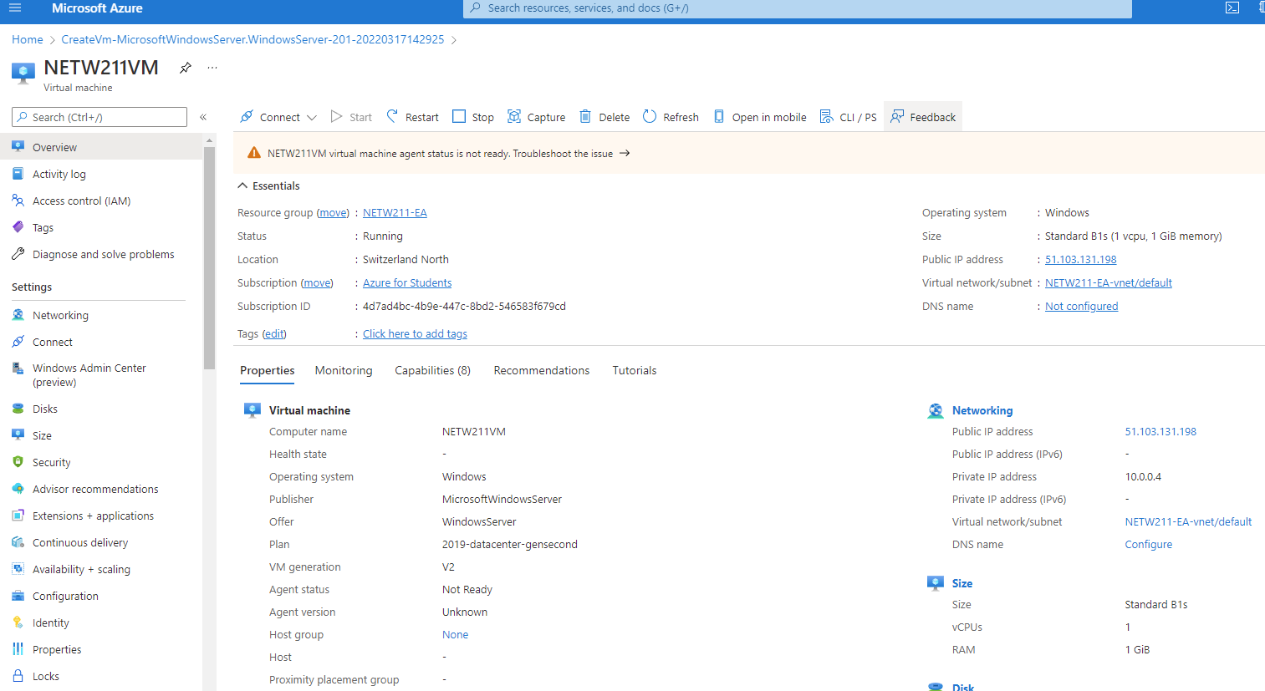
Deploying a VM in Azure
This screenshot should show the NETW211VM page with information such as the resource group name, subscription, public IP address, etc.

Slide 4
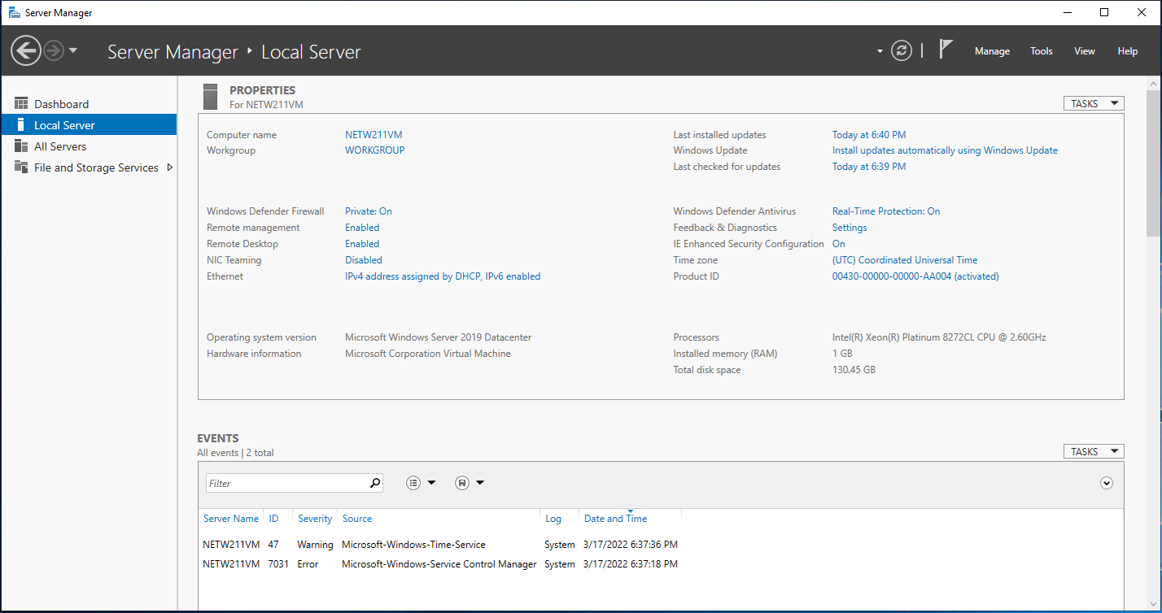
Connecting to the VM
This screenshot should show the PROPERTIES for NETW211VM page, with the computer name, operating system version, hardware information, etc.

Slide 5
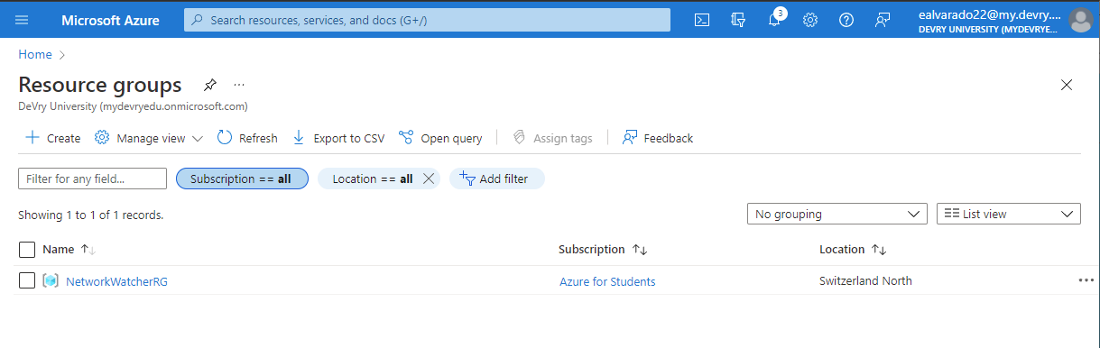
Deleting
the VM
This screenshot should show the Resource groups page, with the Azure for Students subscription selection and the “No resource groups to display” message.

Slide 6
Part 2 Creating VNets and Subnets
In part 2 we learn how to create a Vnet with two subnets
We deploy our virtual machines into our Subnets
We verify connectivity between our virtual machines using the command prompt and ping command.

Slide 7
Creating a VNet with Two Subnets
With a /24 network prefix, how many usable IPv4 host addresses are there?
Answer here: 254
2. Why is the number of available IP addresses for Subnet0 (10.0.0.0/24) or Subnet1 (10.0.1.0/24) shown as 251?
Answer here: The first four addresses in any subnet are reserved and you cannot use for host addresses and the very last address is reserved.
References:
1. https://cloudacademy.com/course/amazon-vpc-networking/vpc-subnets/#:~:text=So%20when%20working%20with%20TCP,assign%20to%20your%20host%20resources.
2. https://forums.aws.amazon.com/thread.jspa?messageID=954362

Slide 8
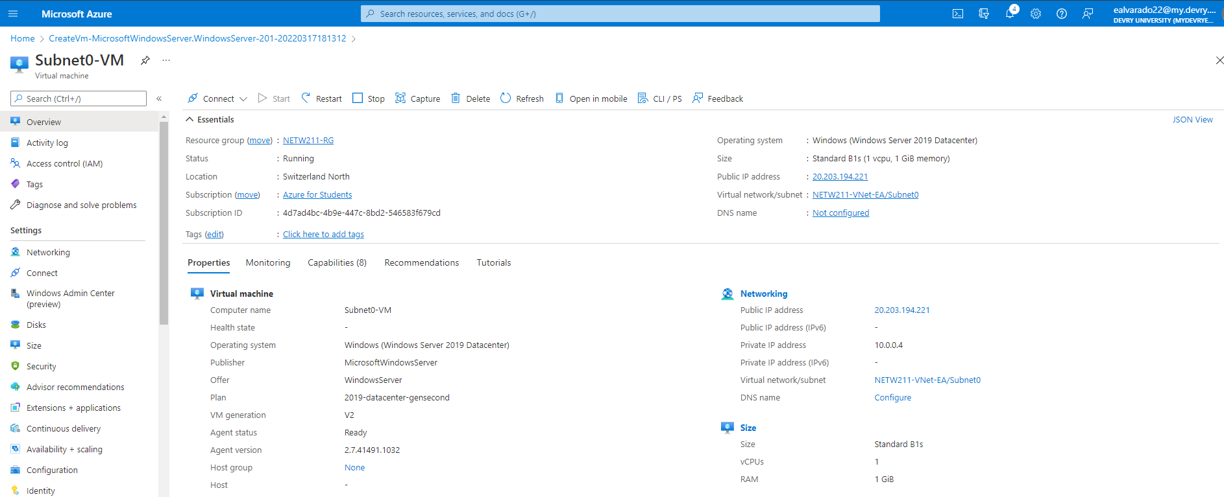
This screenshot should show the Properties section of the Subnet0-VM page, showing the networking and size information of the VM.
Deploying VMs into Subnets

Slide 9
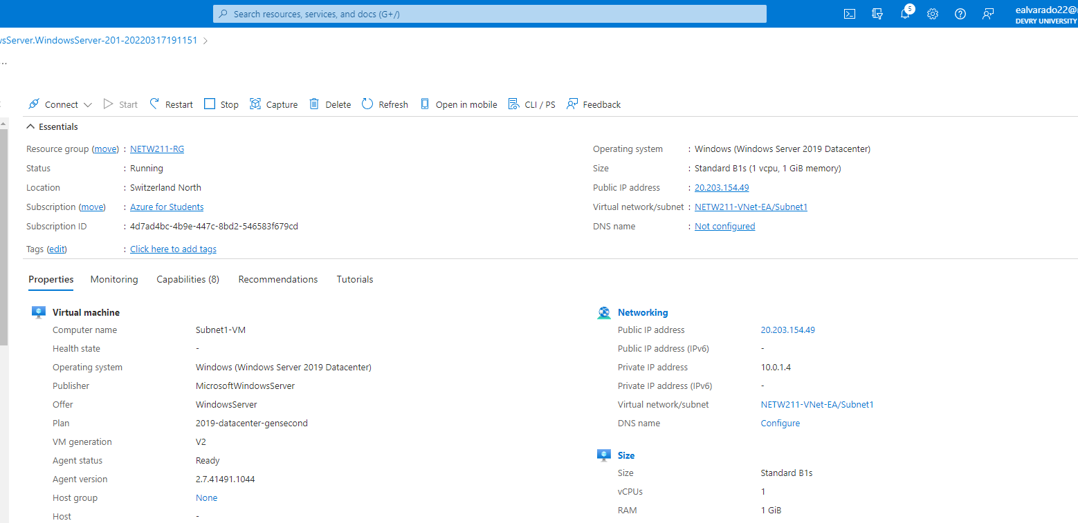
Deploying VMs into Subnets cont’d
This screenshot should show the Properties section of the Subnet1-VM page, showing the networking and size information of the VM.

Slide 10
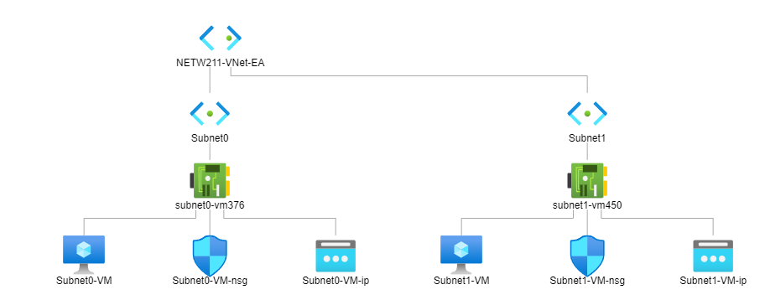
Deploying VMs into Subnets cont’d
This screenshot should show the topology diagram of your VNet (NETW211-VNet-Your Initials) with two subnets (Subnet0 and Subnet1) and one VM in each subnet (Subnet0-VM and Subnet1-VM).

Slide 11
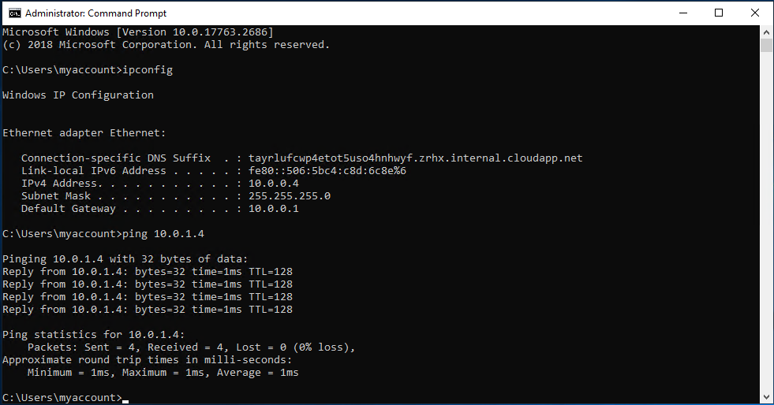
Verifying Connectivity between VMs
This screenshot should show the ipconfig and ping 10.0.0.4 results in the command prompt window, including the Subnet0-VM – 10.0.0.4 – Remote Desktop Connection window title.

Slide 12
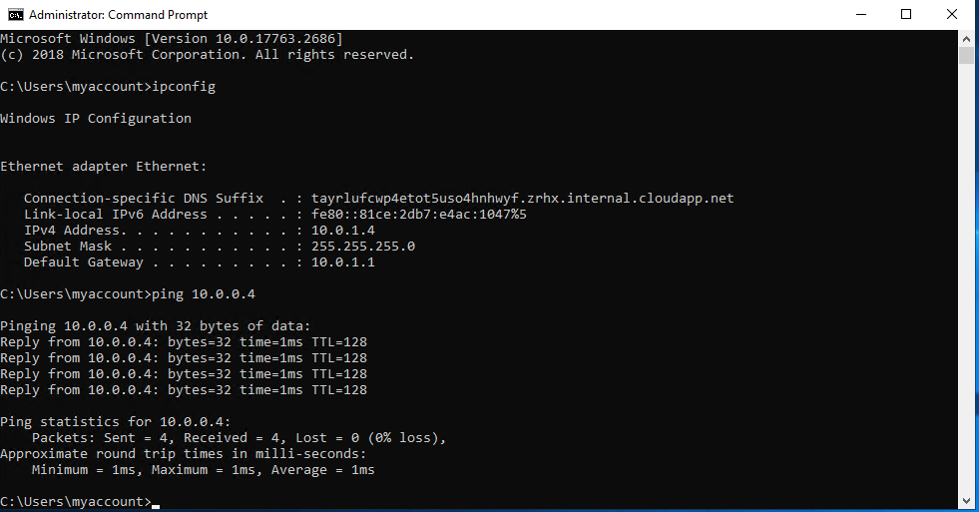
Verifying Connectivity between VMs
cont’d
This screenshot should show the ipconfig and ping 10.0.1.4 results in the command prompt window, including the Subnet1-VM – 10.0.1.4 – Remote Desktop Connection window title.

Slide 13
Part 3 Azure Virtual Machine Security
In part 3 we establish a virtual machine
We then connect to the virtual machine via SSH
Finally, we configure an NSG for our virtual machine.

Slide 14
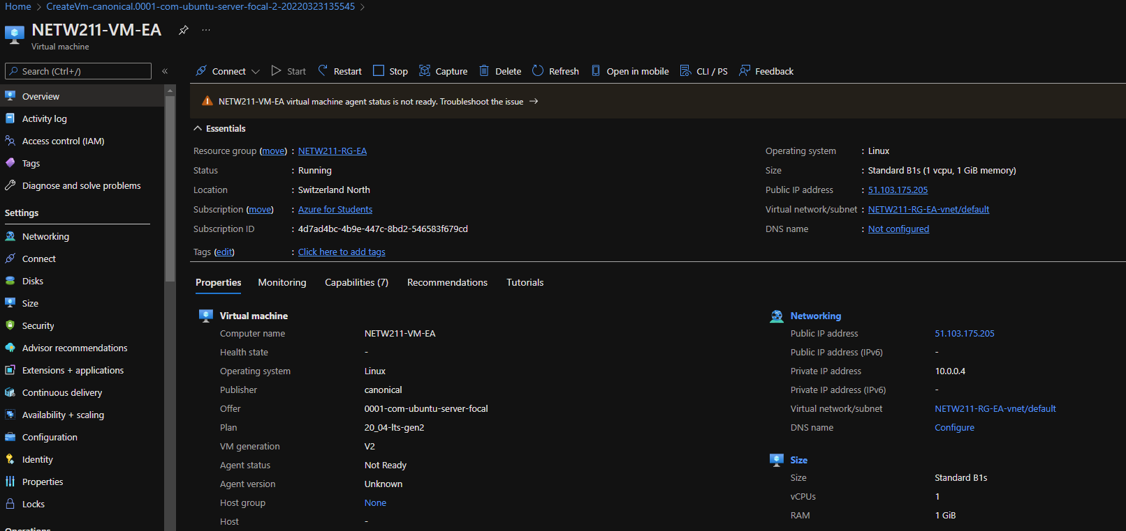
Launching a VM
This screenshot should show the NETW211-VM-Your Initials page, with information such as the resource group name, subscription, public IP address, etc.

Slide 15
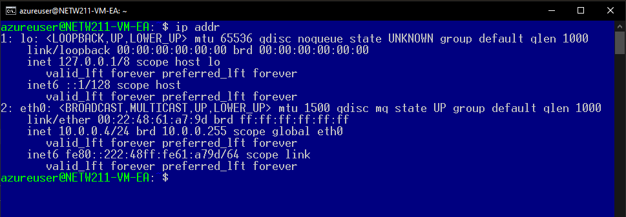
Connecting to the VM
via SSH
This screenshot should show the azureuser@NETW211-VM-Your Initials window showing the IPv4 address of the VM in the Azure cloud.

Slide 16
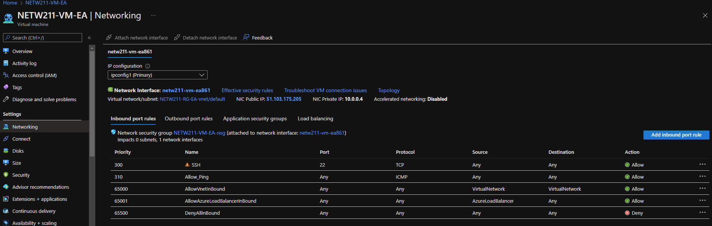
Configuring an NSG
This screenshot should show the Inbound port rules section with the newly added Allow_Ping rule.

Slide 17
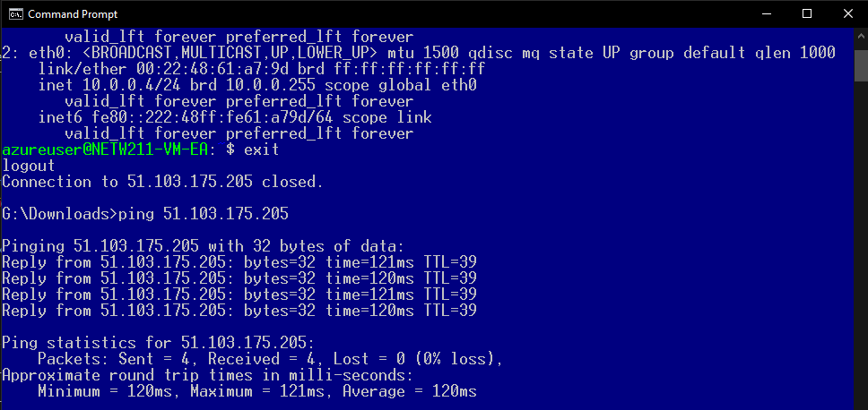
Configuring an NSG
cont’d
This screenshot should show the successful ping result from your local computer to the VM in the Azure cloud.

Slide 18
Part 4 Reviewing Cloud Storage
In part 4 we review cloud storage within the Azure platform
We upload a file and access the file via Azure cloud
We then create Blob snapshots
Next, we enable Blob versioning within our storage.

Slide 19
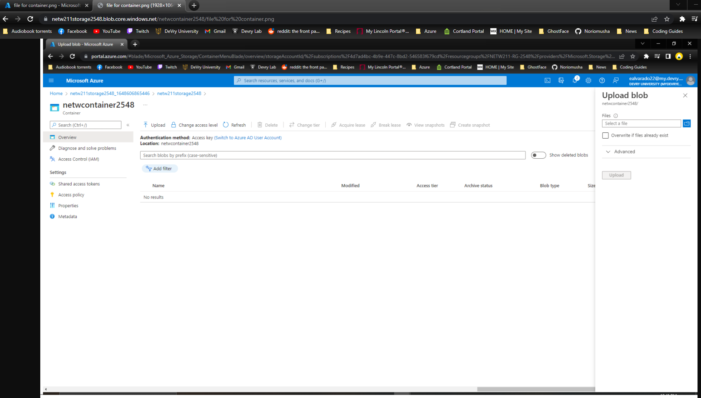
Uploading and Accessing a File
This screenshot should show the browser window with the image uploaded from your local computer and the URL on top of the window.

Slide 20

Question
What does the access tier setting do? What are the Azure blob storage access tiers?
When your data is stored in an online access tier (either Hot or Cool), users can access it immediately. The Hot tier is the best choice for data that is in active use, while the Cool tier is ideal for data that is accessed less frequently, but that still must be available for reading and writing.
Hot tier - An online tier optimized for storing data that is accessed or modified frequently. The Hot tier has the highest storage costs, but the lowest access costs.
Cool tier - An online tier optimized for storing data that is infrequently accessed or modified. Data in the Cool tier should be stored for a minimum of 30 days. The Cool tier has lower storage costs and higher access costs compared to the Hot tier.
Archive tier - An offline tier optimized for storing data that is rarely accessed, and that has flexible latency requirements, on the order of hours. Data in the Archive tier should be stored for a minimum of 180 days.
References:
1. https://docs.microsoft.com/en-us/azure/storage/blobs/access-tiers-overview

Slide 21
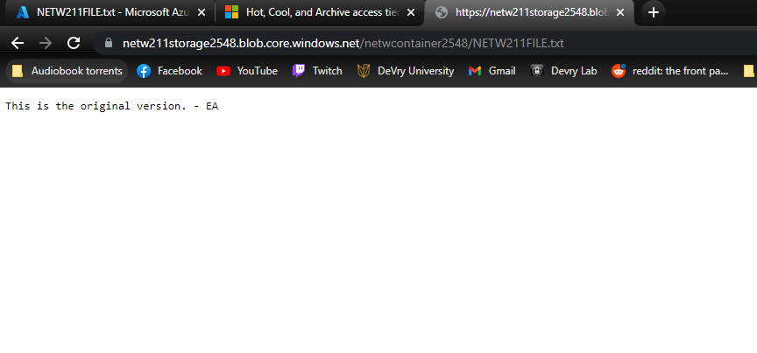
Creating Blob Snapshots
This screenshot should show the browser window with the “This is the original version. –Your Initials” message and the URL on top of the window

Slide 22
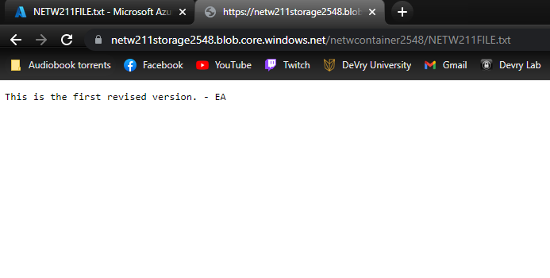
Enabling Blob Versioning
This screenshot should show the browser window with the “This is the first revised version. –Your Initials” message and the URL on top of the window.

Slide 23
Part 5 Cloud Monitoring
In part 5 we review cloud monitoring
We look at setting up an Action group and notifications
Next, we review setting up alert rules
Finally, we test the alerts utilizing our own emails.

Slide 24
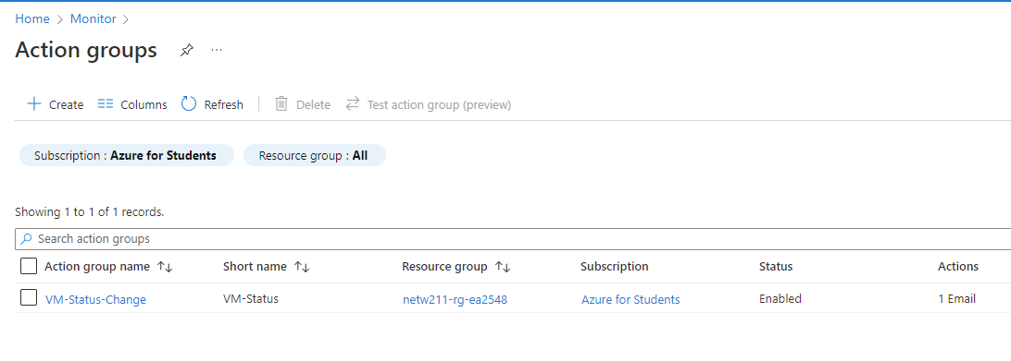
Setting up an Action Group and Notifications
This screenshot should show the “VM-Status-Change” action group on the Manage actions page.

Slide 25
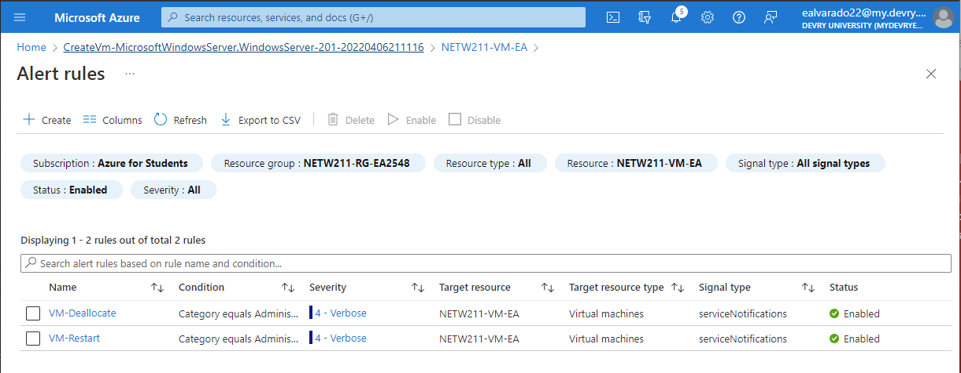
Setting up Alert Rules
This screenshot should show the Alert rules window showing the VM-Deallocate and VM-Restart rules.

Slide 26
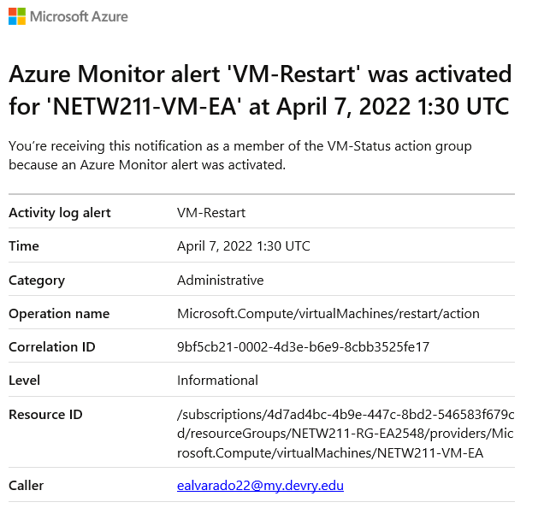
Testing Alerts
This screenshot should show the ‘VM-Restart’ was activated email message with the date and time of the alert.

Slide 27
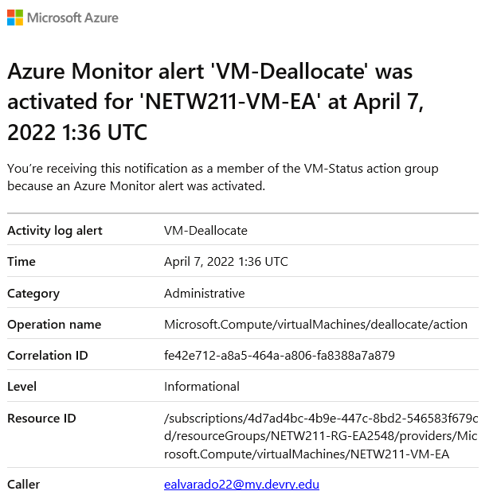
Testing Alerts cont’d
This screenshot should show the ‘VM-Deallocate’ was activated email message with the date and time of the alert.

Slide 28
Course Challenges
In this course the main challenges appeared towards the beginning
Since most of the course is foundational and is consistently building upon itself making sure to fully understand the azure platform and how to properly setup a virtual machine and resource group was the main challenge
Compounding the issue of changing regions to ensure the virtual machine size we needed was available was also a continuous challenge

Slide 29
Career Skills Obtained
Fundamental understanding of the Azure platform
Creating virtual machines, Vnets and Subnets
Improving understanding of Cloud Security
Developing cloud storage understanding
Establishing cloud monitoring skills utilizing built in features of Azure

Slide 30
Conclusion
The Internet of Things is growing exponentially. New technologies and applications are being developed on a regular basis. This creates an abundance of new job opportunities, each with requisite skill sets. It is important to stay current with the skills required for this evolving job market and to take advantage of the many available learning opportunities currently available.
The design and development process of building a system in the Azure Cloud includes Virtual Machine (VM) launch, Virtual Network (VNet) configuration, VM instance security, cloud storage, and cloud monitoring. This foundation empowers the learning of emerging technologies, including IoT, and has prepared me for my future career in Information Technology.

